Slide 1
Welcome to Marketing Management
Dr. Cecilia Ruvalcaba
BUSI 107 Week 8, Day 2

Slide 2
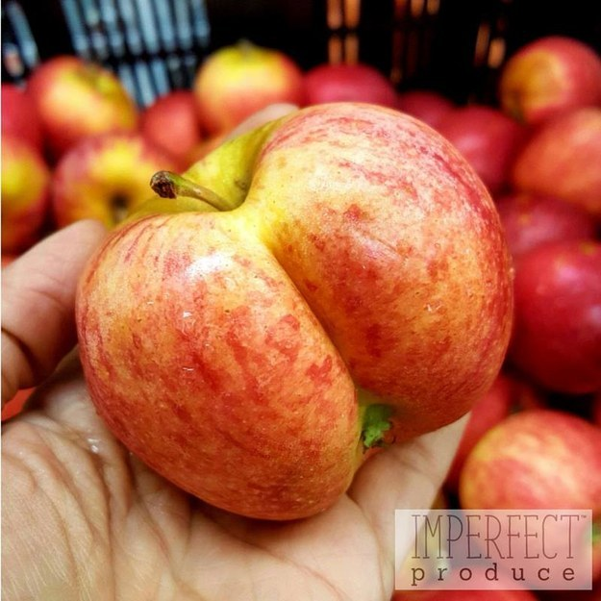

Notes:
The Fruit At Whole Foods May Start To Look Really Ugly And It Might Be A Good Thing
http://www.buzzfeed.com/leticiamiranda/the-fruit-at-whole-foods-may-start-to-look-really-ugly-and-i#.vbzbErzXk7

Slide 3
New Products

Slide 4
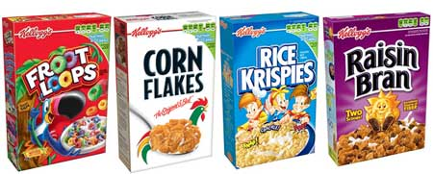


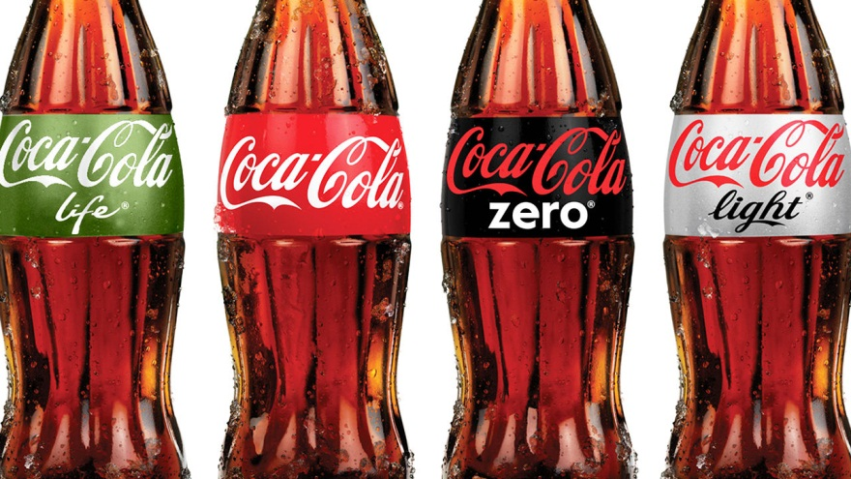
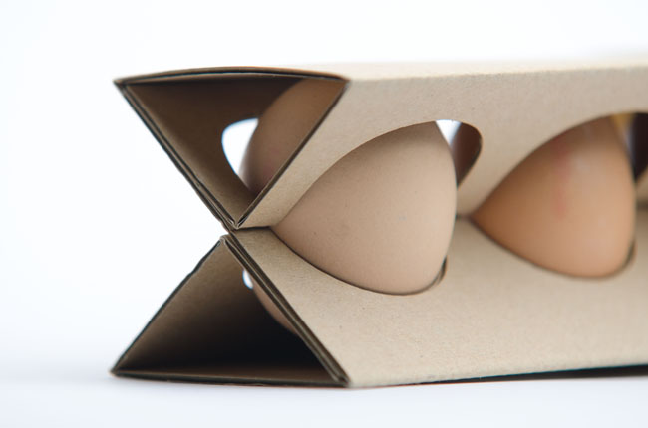
Why Create New Products?

Slide 5

Starbucks
Howard Schultz “Third Place”
Key strategies of success
Keeping employees happy
Creating this new conception of coffee drinking
Socially Responsible business practices
Issues
Slowing Growth (over saturation)
Increased Competition
Brand Image (premium vs. fast food)
Discussion Points
Continued Growth?

Slide 6
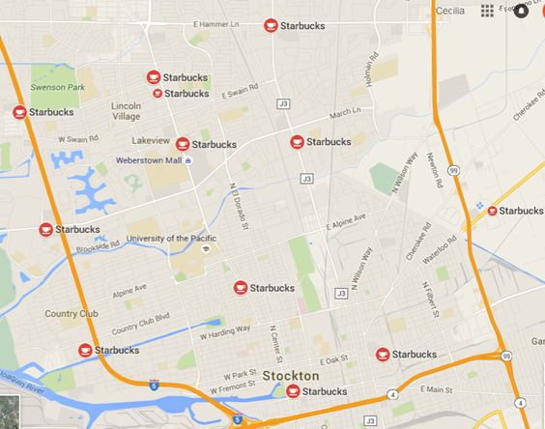
Where to next?
Line Extension
Uses a well-known brand name to enter into a new market segment
Coke -> Diet Coke
Brand Extension
Uses a current brand name to enter a completely different product class
Jello -> Jello Pudding Pops
What “job” does it do? For who?

Slide 7


Take Away for Today
“People don't want a quarter-inch drill--they want a quarter-inch hole”
-Ted Levitt
What job will your product/service fulfill?

Slide 8

Next Class
Chapter 11: Product, Branding, and Packaging Decisions & Chapter 12: Developing New Products cont…
Extended Outline due Friday 3/11

